Slide 1
Lipid Chemistry
Dr. Sapna Patel
SR
Biochemistry Department,
GMCB.

Slide 2
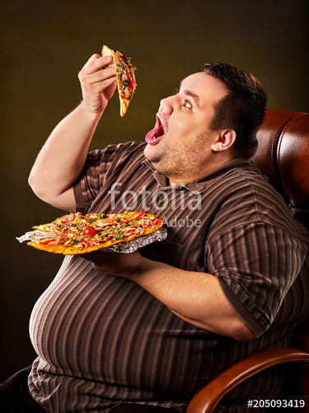

Slide 3
WHO classification of weight status

Slide 4
BMI Body comparison

Slide 5
Skin caliper for fat measurement

Slide 6
• Is fat require in food?
• What type of fat is require?
• Why require?

Slide 7
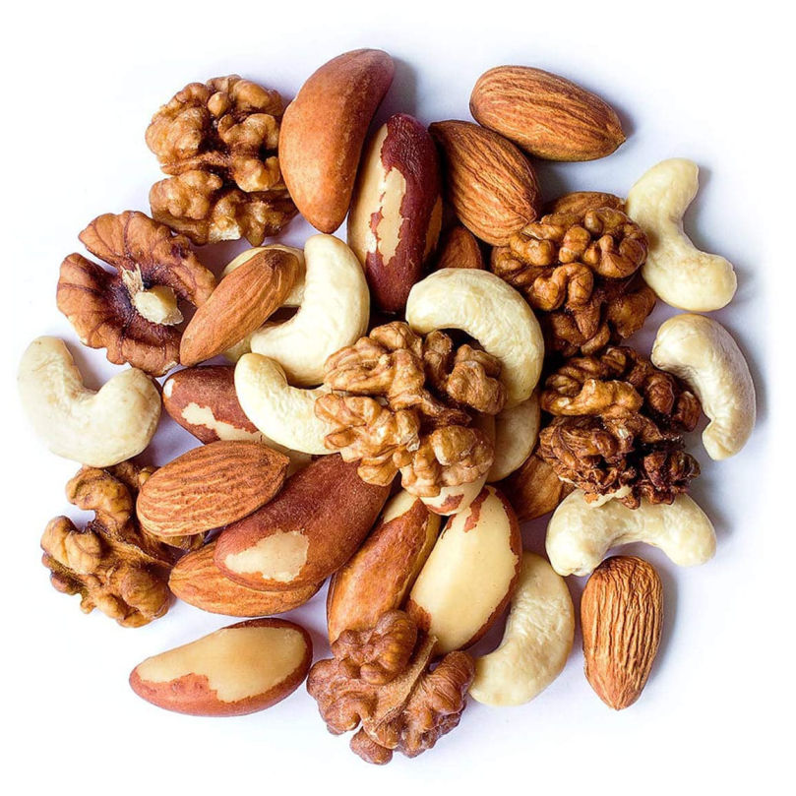
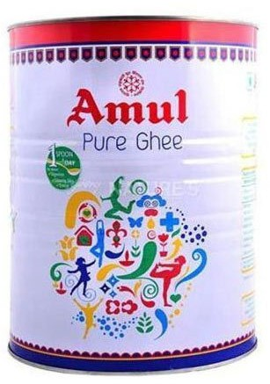
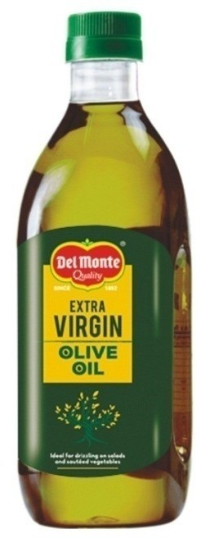
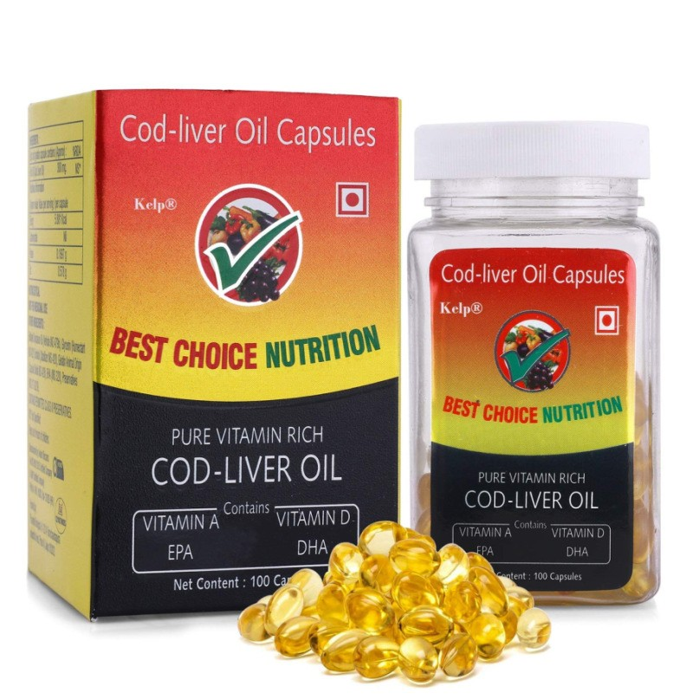
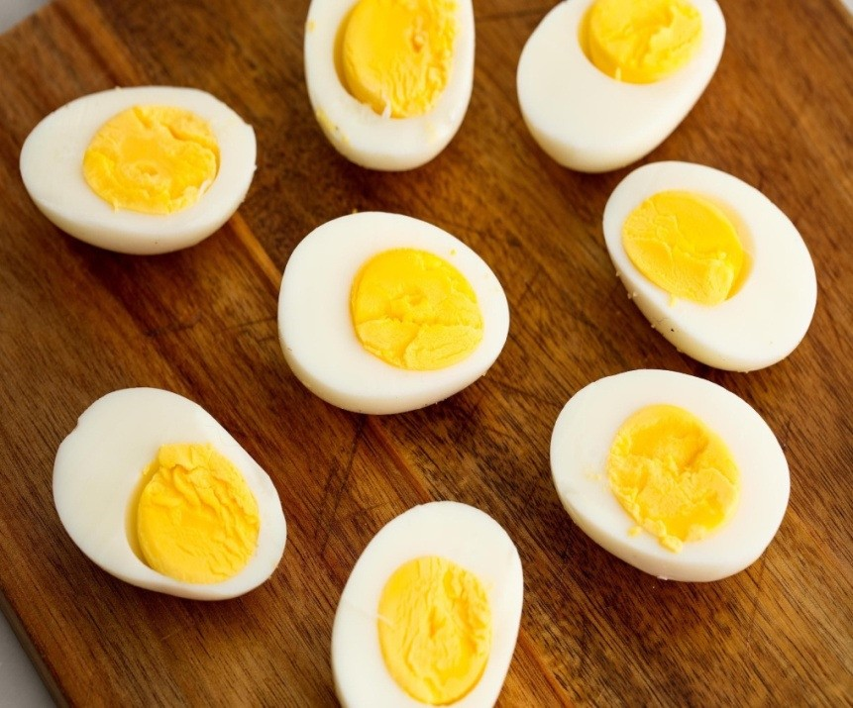

Slide 8
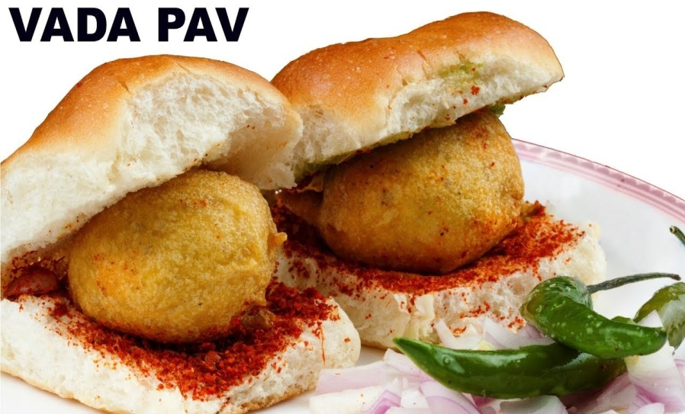
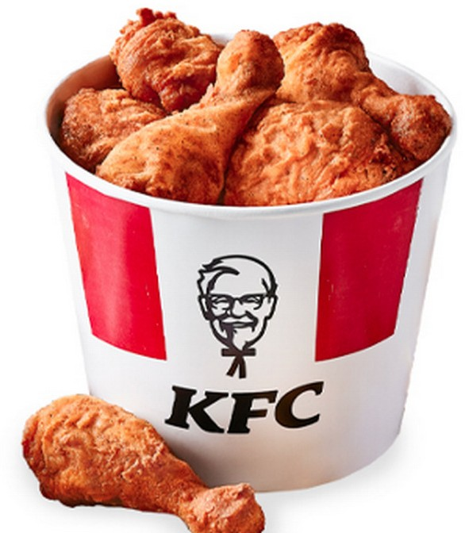
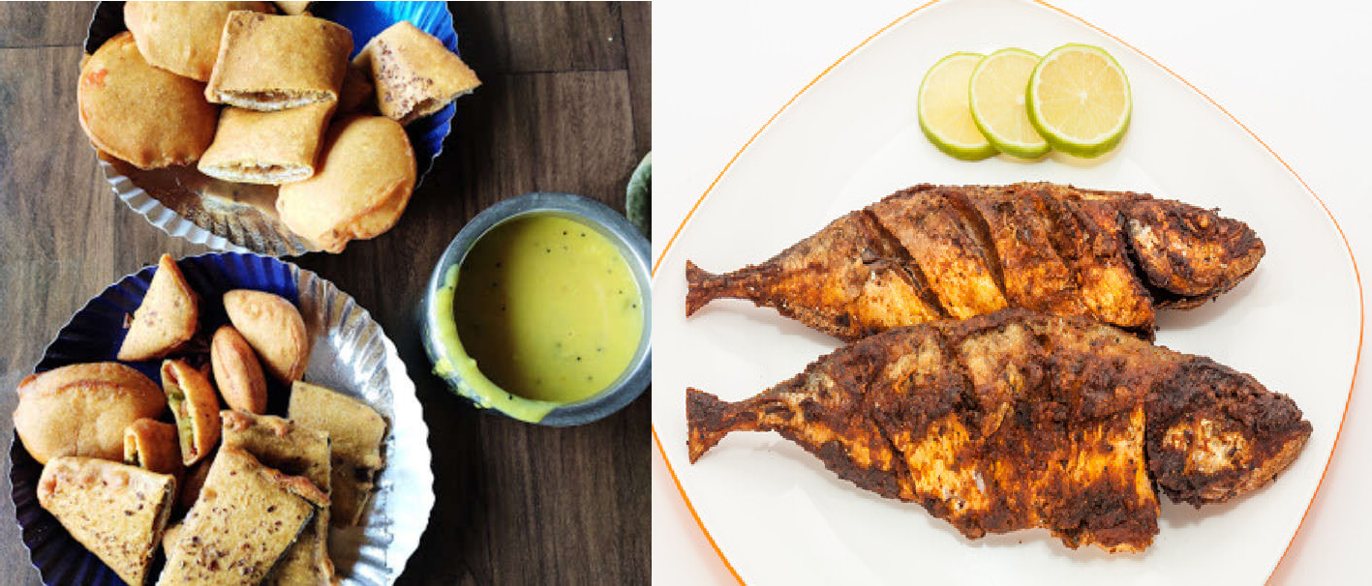

Slide 9
Biomedical importance of lipid
Structural components of bio membrane (phospholipids and cholesterol)
Hormones (steroids and vitamin D)
Precursors of prostanoids and leukotrienes,
Emulsifying agents in the digestion and absorption of lipids (bile acids), and
Surfactants in the alveolar membrane (phosphatidylcholine)
Absorption of vitamins A, C, D, E, and K
Improve taste & palatability of food
Give shape & contour to the body
Thermal insulation
Protect internal organs by providing cushioning effect
Energy storage (as triacylglycerol), metabolic fuels
Participate in structure of all cellular and sub cellular membranes.
Essential for skin integrity, normal growth and reproduction.
Important role in blood clotting.

Slide 10
Functions of Essential Fatty Acid
Biomedical importance of ω3 fatty acids
Dietary supplementation with long-chain ω3 fatty acids is believed to have effects in a number of chronic diseases
Decreases platelet aggregation
Reduce inflammation
Decreases hyperlipidemia
Decreases cardiovascular diseases
Decreases mental illness like depression & ADHD
Beneficial in degenerative disorders like rheumatoid arthritis
Require for Retinal & Brain development

Slide 11
Introduction
Lipids are a Heterogenous group of compounds, that are insoluble in water but soluble in non polar solvents like Acetone, Benzene, Chloroform, Ether.
Very short chain fatty acids and ketone bodies are readily soluble in water.
Lipids may be polar or nonpolar (amphipathic).

Slide 12
Classification of lipid
SIMPLE LIPIDS
COMPOUND LIPIDS
DERIVED LIPIDS
LIPIDS COMPLEXED TO OTHER COMPOUNDS

Slide 13
I- Simple lipids:
Fatty acids + Alcohol = Esters of fatty acid
Classified according to the alcohol present into:
1) Neutral fats: Fatty acids + Glycerol
e.g. Triacylglycerols - Triglycerides
2) Waxes:
Fatty acids + long-chain alcohols other than glycerol.
e.g. Waxe

Slide 14
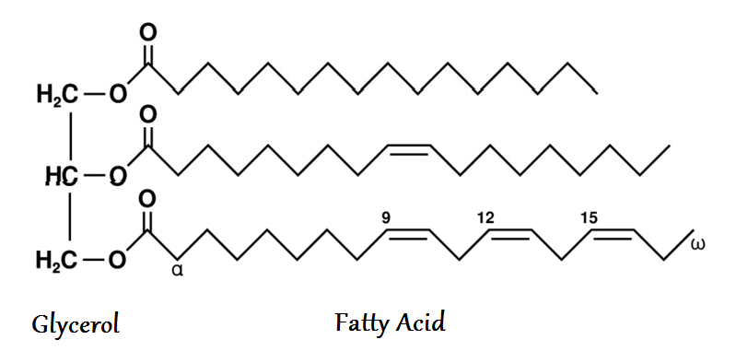
Triglyceride

Slide 15
Triglycerides
Stored mainly in adipocytes.
A store of energy.
Protect the internal organs from outside shocks.
Subcutaneous thermal insulator

Slide 16
Triglycerides
Simple triacylglycerols: containing same kind of fatty acid in all three positions
Simple triacylglycerols of 16:0, 18:0, and 18:1, for example, are tripalmitin, tristearin, and triolein respectively.
mixed triacylglycerols: they contain two or three different fatty acids. Most naturally occurring triacylglycerols are mixed
Because the polar hydroxyls of glycerol and the polar carboxylates of the fatty acids are bound in ester linkages, triacylglycerols are nonpolar, hydrophobic molecules, essentially insoluble in water

Slide 17
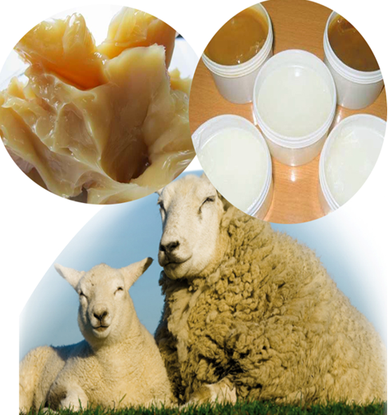
Waxes

Slide 18
Waxes
Containing a Long Chain Alcohol (with a higher molecular weight than Glycerol)
E.g. Palmitoyl alcohol, cholesterol, vitamin A or D.
Esterified to long-chain fatty acids.
Derived from secretions of insect, leaves, fruits and marine animals i.e. bees wax, wool fat/ lanolin
Properties of waxes:
Waxes are insoluble in water
soluble in fat solvents
Not easily hydrolyzed
Not digestible by lipases.
Very resistant to rancidity.
No nutritional value.
Used as base for preparation of cosmetics, ointments, polishes, lubricants, candles

Slide 19
Grooming

Slide 20
Alcohols
Include: Glycerol, Cholesterol, higher alcohols etc.
1. Glycerol:
Structure:
Properties:
Colorless & Viscous oily
Sweet taste.
Soluble in water and alcohols
Monoglyceride or monoacyl-glycerol= glycerol + 1 fatty acid .
Diglyceride or diacyl-glycerol= glycero+ 2 fatty acids.
Triglyceride or triacyl-glycerol = glycerol + 3 fatty acids.

Slide 21
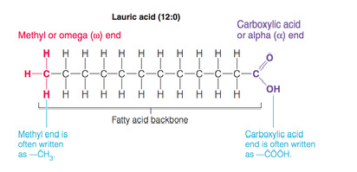
Fatty acids
Fatty acids are carboxylic acids with hydrocarbon chains ranging from 4 to 36 carbons long (C4 to C36)
Fatty acids exist “free” in the body only during metabolism of TAG. and as fatty acyl esters in more complex molecules such as triacylglycerols (TAGs)
They are generically indicated by the chemical formula R-COOH, where “R” stands for an alkyl chain

Slide 22
CLASSIFICATION OF FA
Depending on number of carbon atoms
Even chain Odd chain
Have carbon atoms 2,4,6 Have carbon atoms 3,5,7
Most naturally occurring lipids seen in microbial cell walls. also
Have even chain FA present in milk.
2) Depending on length of hydrocarbon chain
Short chain Medium chain long chain Very long
(2-6) (8-14) (16-24) chain(>24)

Slide 23
3) Depending on nature of hydrocarbon chain
Saturated Unsaturated branched chain Hydroxy
FA FA FA FA
Mono-unsaturated poly-unsaturated
Having single double with 2 or more double bond bond

Slide 24
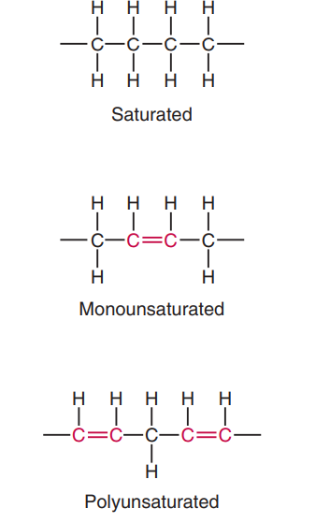

Slide 25
SATURATED FATTY ACIDS
Common name | No of carbon atoms | Chemical nature | Occurrence
Acetic acid | 2 | Saturated; small chain ;even chain | Vinegar
Butyric acid | 4 | Do | Butter
Caproic acid | 6 | Do | Butter
Capric acid | 10 | Do | Coconut oil
Lauric acid | 12 | Do | Coconut oil
Myristic acid | 14 | Do | Coconut oil
Palmitic acid | 16 | Saturated; long chain | Body fat
Stearic acid | 18 | Do | Body fat
Arachidic acid | 20 | Do | Peanut oil
Propionic acid | 3 | Saturated; odd chain | metabolism

Slide 26
Classification of FA
Fatty acids can be classified as follows: their degree of saturation
I) Saturated Fatty acid,
No double bonds
2-24 or more carbons. C_{n}H_{2n+1}COOH.

Slide 27
II) Unsaturated,: They contain one or more double bonds
a) Monounsaturated,(monoethenoid, monoenoic) C_{n}H_{2n-1}COOH
Examples:
Palmitoleic acid:CH₃-(CH₂)₅-CH=CH-(CH₂)₇-COOH
Oleic acid:CH₃-(CH₂)₇-CH=CH-(CH₂)₇-COOH
Nervonic acid:CH₃-(CH₂)₇-CH=CH-(CH₂)₁₃-COOH
b) Polyunsaturated, (polyethenoid, polyenoic) (Essential fatty acids)
contain more than 1 double bond
Linoleic Acid
Alpha Linolenic Acid (ALA)
Arachidonic

Slide 28
The structures and nomenclature of the fatty acids

Slide 29
Omega classification of fatty acid
Depending on the position of first double bond from the terminal end, the fatty acids are again classified into.
ω 3 | • α Linolenic Acid • Timnodonic Acid (Eicosa pentaenoic Acid) • Cervonic Acid (Docosa Hexaenoic Acid) (DHA)
ω 6 | Linoleic Acid • Linolenic Acid (GLA) • Arachidonic Acid
ω 9 | Oleic Acid • Elaidic Acid

Slide 30
Essential Fatty Acid
Linoleic: C18:2Δ^{9, 12} ( ω6)
CH3-(CH2)4-CH=CH-CH2-CH=CH-(CH2)7-COOH
Linolenic: C18:3Δ^{9, 12,15} ( ω3)
CH3-CH2-CH=CH-CH2-CH=CH-CH2-CH=CH-(CH2)7- COOH
Arachidonic acid: C20:4Δ^{5, 8, 11, 14} ( ω6)
CH3-(CH2)4-CH=CH-CH2-CH=CH-CH2-CH=CH-CH2- CH=CH-(CH2)3-COOH

Slide 31
Linoleic acid and Linolenic acid are PUFA
Linoleic acid – 2 double bond
Linolenic acid – 3 double bond
Humans have carbon 9, 6, 5 and 4 desaturases,
Can convert in saturated fatty acid it into unsaturated fatty acid.
Lack to introduce double bonds after 10th carbon from carboxyl ,towards the ω-end (methyl end) of the chain.
Linoleic acid is the precursor of arachidonic acid for formation of prostaglandin , leukotrienes and thromboxone synthesis (Eicosanoids synthesis).

Slide 32
Functions:
Prostaglandin & eicosanoids are synthesized
Neurotrasmittter
Useful to prevent atherosclerosis.
Participate in structure of all cellular and subcellular membranes.
Essential for skin integrity, normal growth and reproduction.
Important role in blood clotting.
They can be oxidized for energy production.

Slide 33
.

Slide 34
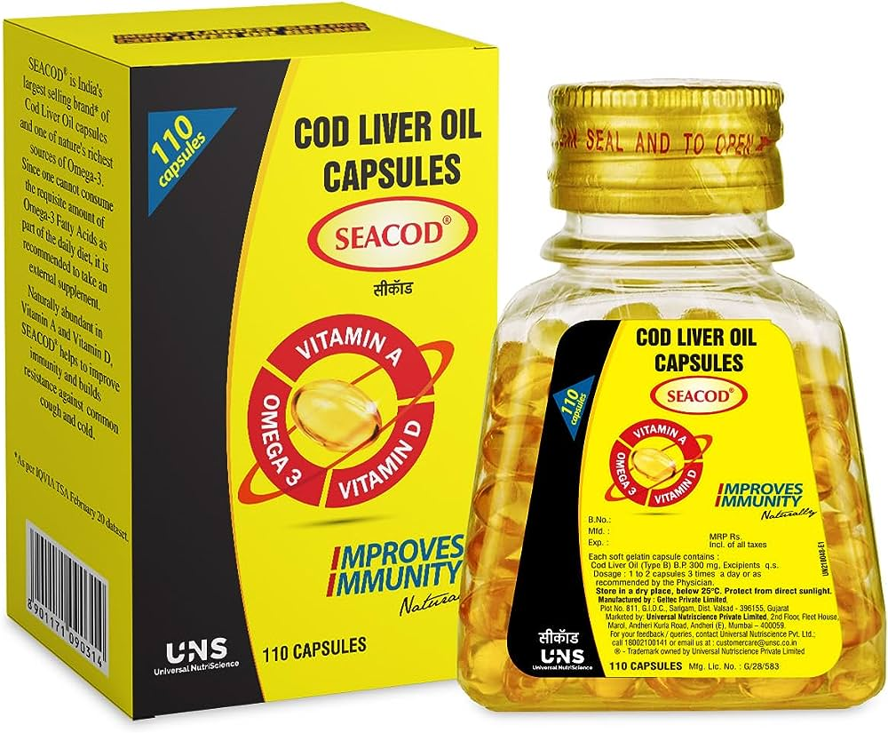

Slide 35
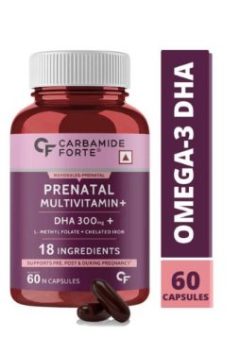
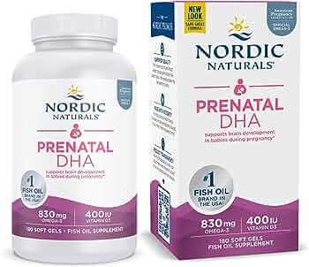

Slide 36
Functions of Essential Fatty Acid
Biomedical importance of ω3 fatty acids
Dietary supplementation with long-chain ω3 fatty acids is believed to have effects in a number of chronic diseases
Decreases platelet aggregation
Reduce inflammation
Decreases hyperlipidemia
Decreases cardiovascular diseases
Decreases mental illness like depression & ADHD
Beneficial in degenerative disorders like rheumatoid arthritis
Require for Retinal & Brain development

Slide 37
III- Hydroxy fatty acids
-They contain one or more hydroxyl groups, Examples:
Oxynervonic (24:1Δ¹⁵, hydroxy at C₂),
Crebronic (24: hydroxy at C₂)
IV- Branched chain fatty acids:
There are fatty acids with branched chains
Examples:
Phytanic acid that is a by-product of chlorophyll catabolism in human and animal. If it is not oxidized in the body it will be toxic.

Slide 38
Isomerism in fatty acids

Slide 39
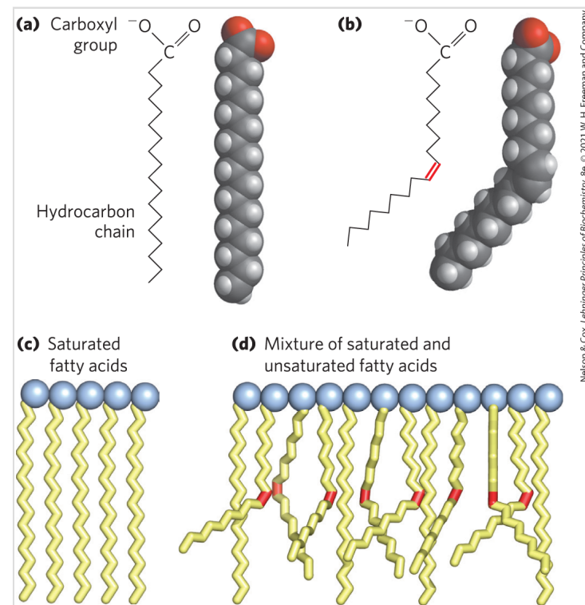
30° bend
Notes:
In saturated fatty acids, the acyl chain is extended and flexible (i.e., the carbon atoms rotate freely around the longitudinal axis), and each internal carbon atom is fully saturated or, in other words, is covalently linked to two hydrogen molecule

Slide 40
They are used in food industry to improve the shelf life
Trans fatty acids are present in high amounts in processed foods, fast foods and bakery items and fried foods
Trans fatty acid compete with essential fatty acid, hence exacerbate essential fatty acid deficiency
Trans fatty acid can not be utilize by the body due to deficiency of enzymes.
Consumption of trans fatty acid for long terms may raise the risk factor for cardiovascular diseases like Atherosclerosis and Coronary Artery disease and Diabetes mellitus.

Slide 41
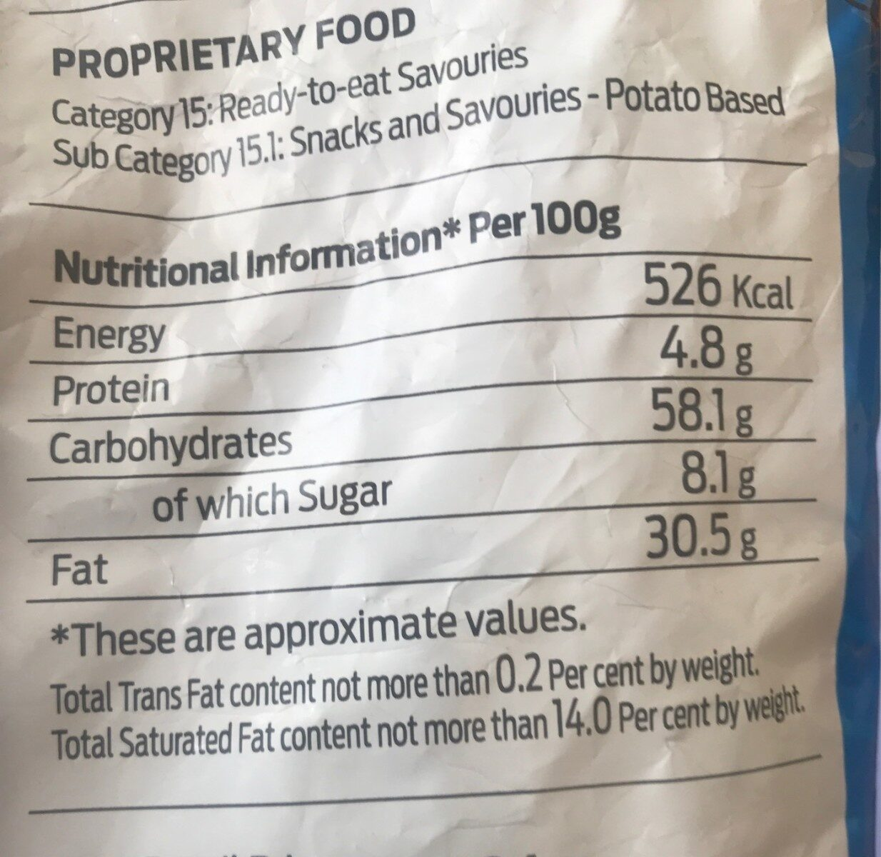
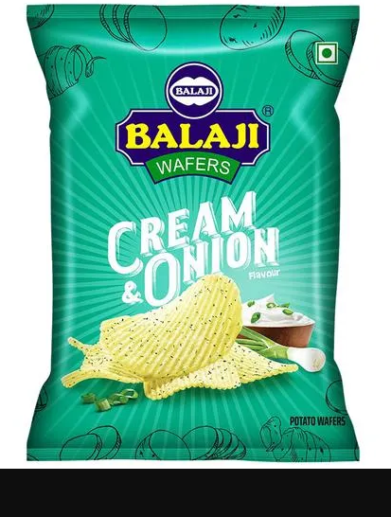

Slide 42
Rancidity
Definition:
Physico-chemical change in the fat
Leading to the development of
Unpleasant odour
Unpleasant taste or
Abnormal color
Because of
Exposure to atmospheric oxygen
Light
Moisture
Bacterial or fungal contamination
Heat.
Types and causes of Rancidity:
Hydrolytic rancidity
Oxidative rancidity
Ketonic rancidity

Slide 43
Prevention of rancidity is achieved by:
Avoidance of the causes
Exposure to light, oxygen, moisture, high temperature and bacteria or fungal contamination.
Keeping fats in well-closed containers in cold, dark and dry place.
Addition of anti-oxidants.
Vitamin E

Slide 44
Hazards of Rancid Fats:
Can causes food poisoning and cancer.
Destroys the fat-soluble vitamins
(vitamins A, D, K and E).
Destroys the polyunsaturated essential fatty acids.
Convert Cis toTrans form
Economical loss
Because it is unfit to eat.

