Slide 1
Specimen Collection and Processing
Dr Sapna Patel
MD Biochemistry
Government Medical College,
Bhavnagar

Slide 2
BASIC STEPS
1. Identification
Active process
Name
Age
Sex
Mrd no.
Address
Id in case of medico legal cases
Signed consent in genetic disease
Guardian consent in pediatric pt

Slide 3
2 Universal precautions must be followed when collecting specimen.
A phlebotomist should dress in personal protective equipment (PPE)
Face mask and goggles
History of latex allergies of pt

Slide 4
3. Basic pt preparation
Fasting
History of medication
Position (seated/supine). At no time should venipuncture be performed on a standing patient
Arms should be extended in a straight line from the shoulder to the wrist
Arm with inserted intravenous line should be avoided, as should an arm with extensive scarring or a hematoma
If h/o mastectomy then arm veins on that side of the body should not be used, because of lymphostasis. if double mastectomies, blood should be drawn from the arm of the side on which the first procedure was performed. If the surgery was done within 6 months on both sides, a vein on the back of the hand or at the ankle should be used.

Slide 5
4. Location
Median cubital vein in the antecubital fossa is pref in adults(large close to surface)
Veins on the back of the hand or at the ankle may be used, although these are less desirable and should be avoided in people with diabetes and other Individuals with poor circulation
collect blood through a cannula that is inserted for long-term fluid infusions at the time of first insertion to avoid the need for a second stick.
Arm containing a cannula or an arteriovenous fistula should not be used
If fluid is being infused intravenously into a limb, the fluid should be shut off for 3 minutes

Slide 6
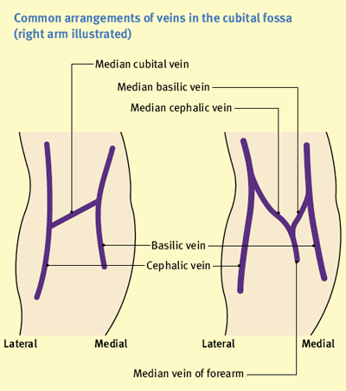

Slide 7
5. Preparation of Site
Three commonly used materials
Pre-packaged alcohol swab
Gauze pad saturated with 70% isopropanol
Benzalkonium chloride solution (Zephiran chloride solution, 1 : 750)
Cleaning of the puncture site should be done with a circular motion and from the site outward.
The skin should be allowed to dry in the air.
No alcohol or cleanser should remain on the skin because traces may cause hemolysis

Slide 8
6. Timing
The time at which a specimen is obtained is important for those blood constituents that undergo marked diurnal variation (e.g., corticosteroids, iron)
For those used to monitor drug therapy[Most TDM protocols require sampling at trough (i.e., immediately before the next scheduled dose), particularly for compounds with short halflives or variable pharmacokinetics]
Important in relation to specimens for alcohol or drug measurements in association with medico-legal considerations
For most current molecular diagnostic tests, the time of day is unlikely to contribute to altered or invalid test results.

Slide 9
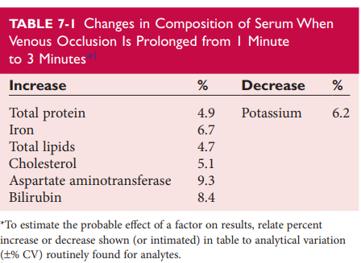
Venous Occlusion
Blood pressure cuff (60 mm Hg)or a tourniquet is applied 4 to 6 inches (10 to 15 cm) above the intended puncture site (distance for adults). For one minute. Marked changes are seen in 3 minutes.
Composition of blood drawn first—that is, the blood closest to the tourniquet—is most representative of the composition of circulating blood. Calcium should be done by first draw

Slide 10
Pumping Increases: potassium, phosphate, lactate, ionized Calcium. lowers: pH
Stress associated with blood collection increase: cortisol , growth hormone, plasma glucose
Increase in activity of creatine kinase and aspartate aminotransferase in serum seen after venipuncture may be caused by hemoconcentration, by slight trauma to tissue as the needle pierces the skin, and by stasis of blood in the tissue

Slide 11
Blood collection Apparatus
Evacuated tubes
Winged (butterfly) set
Blood collection with syringe
Capillary blood tubes
Filter paper for molecular genetic testing and neonatal screening

Slide 12
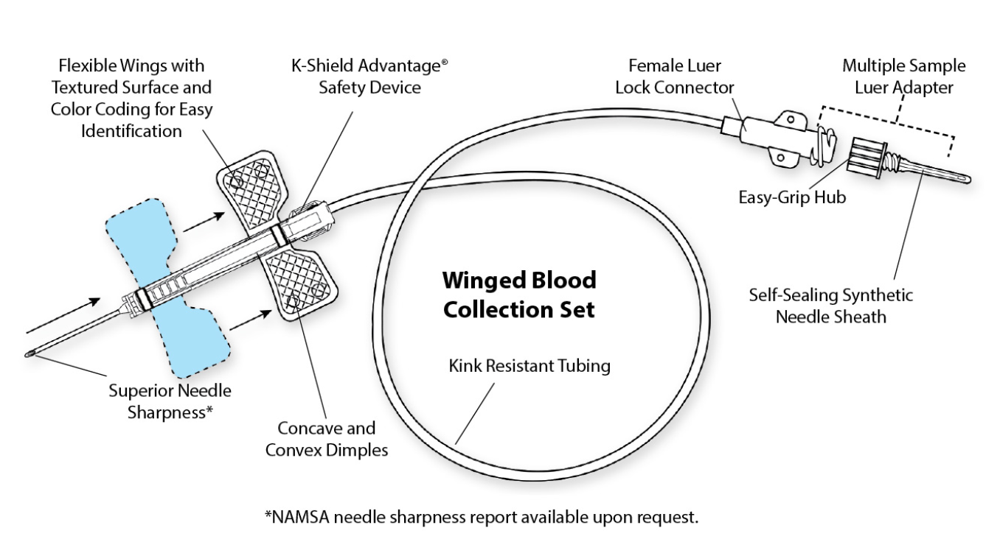
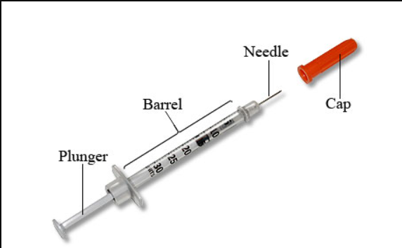

Slide 13
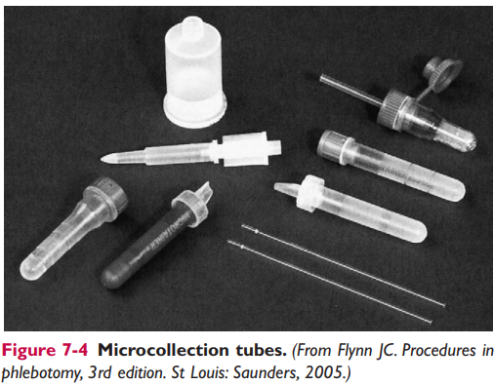
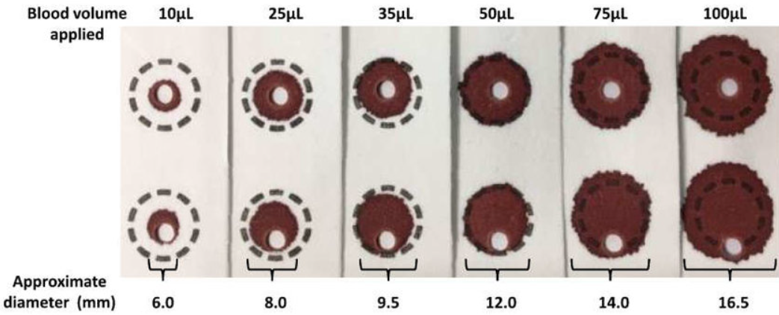

Slide 14
Evacuated blood tubes may be made of sodalime or borosilicate glass or plastic (polyethylene terephthalate).
Plasma separator tubes are available that contain an inert, thixotropic, polymer gel material with a specific gravity of 1.04. A minimum relative centrifugal force (RCF) of 1100 ×g is required for gel release and barrier formation in most tubes.
Stoppers may contain zinc, invalidating the use of evacuated blood tubes for zinc measurement, and TBEP [tris(2- butoxyethyl) phosphate], a constituent of rubber, which may interfere with the measurement of certain drugs.
Blood collected into a tube containing one additive should never be transferred into other tubes, because the first additive may interfere with tests for which a different additive is specified
Additional tubes, not listed, are sold for special applications, such as RNA isolation.

Slide 15
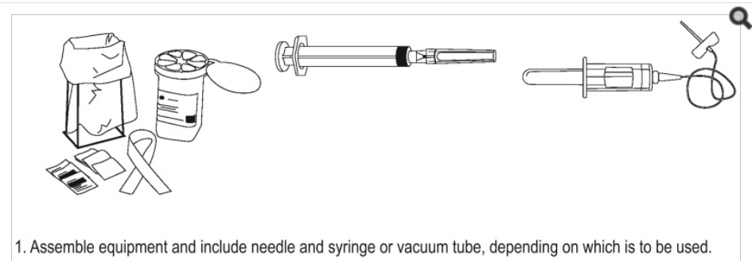
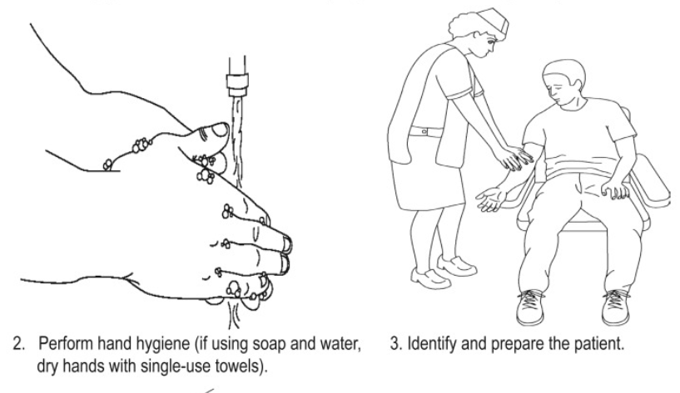
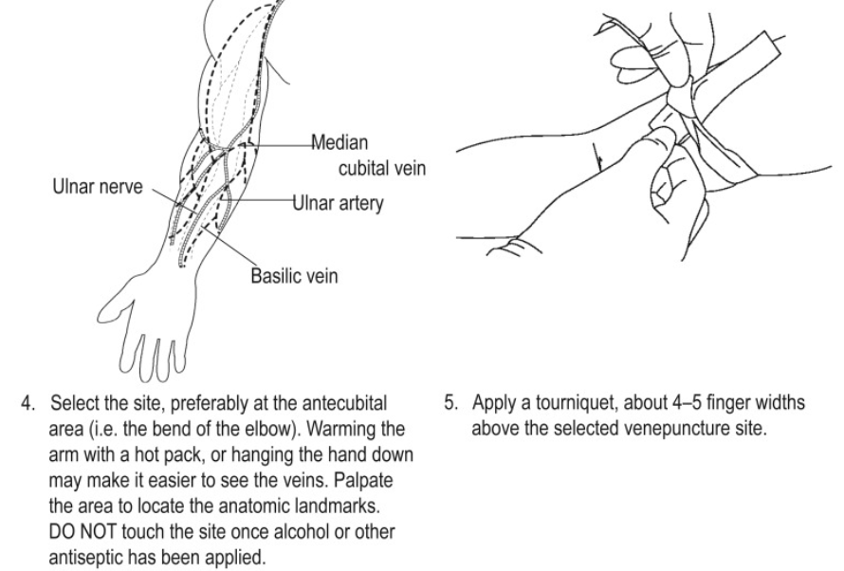
Blood collection SOP

Slide 19
Venepuncture in Children
Children are likely to make unexpected movements, and assistance in holding them still is often desirable.
A syringe should be the tuberculin type or should have a 3-mL capacity, except when a large volume of blood is required for analysis
21- to 23-gauge needle or a 20- to 23-gauge butterfly needle

Slide 20
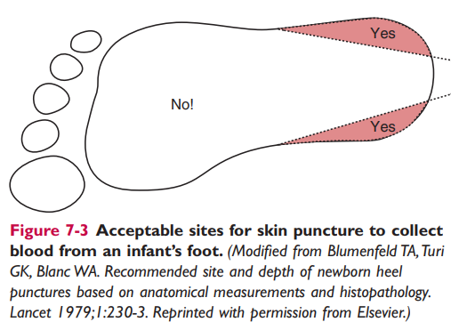
Skin Puncture
Skin puncture is an open collection technique in which the skin is punctured by a lancet and a small volume of blood is collected into a microdevice.
more like arterial blood than venous blood.
It is done when:
Sample volume is limited (e.g., pediatric applications)
Repeated venipunctures have resulted in severe vein damage
Patients have been burned or bandaged and veins therefore are unavailable for venipuncture.
Performed on tip of a finger, earlobe heel or big toe of infants
Massage of the finger to stimulate blood flow should be avoided because it causes the outflow of debris and tissue fluid, which does not have the same composition as plasma.

Slide 21
Arterial Puncture
Preferred sites of arterial puncture are, in order, the (1) radial artery at the wrist, (2) brachial artery in the elbow, and (3) femoral artery in the groin.
In the neonate, an indwelling catheter in the umbilical artery is best to obtain specimens for blood gas analysis.
Young child or infant, it is the heel.
Older child or adult in whom it is impossible to perform an arterial puncture, a capillary puncture may be performed to obtain arterialized capillary blood.
Heparinized capillary tubes containing a small metal bar are used to collect the blood. Tubes should be sealed quickly and the contents mixed well by using a magnet to move the metal bar up and down in the tube so that a uniform specimen is available for analysis.

Slide 22
Separation and Storage of Specimens
Plasma or serum should be separated from cells as soon as possible and certainly within 2 hours.
If it is impossible to centrifuge a blood specimen within 2 hours, the specimen should be held at room temperature rather than at 4 °C to decrease hemolysis.
4 °C or −20 °C is not the optimum storage temperature for all tests; some lactate dehydrogenase isoenzymes, for instance, are more stable at room temperature than at 4 °C.

Slide 23
Transport of Specimens
Polypropylene and polyethylene containers are usually suitable for specimen transport. Glass should be avoided, Polystyrene is unsuitable
Teflon-lined screw cap that does not loosen under the variety of temperatures to which the container may be exposed.
materials of both stopper and container must be inert
DNA - transported in a buffer solution or water, or it can be dried down and shipped as a loose powder
Secondary container - prevent the tubes from banging against each other.
Dry ice is the most convenient refrigerant material −70 °C

Slide 24
THANK YOU

