Slide 1
Regulation of Blood Glucose

Slide 2
Regulation of Blood Glucose
Regulation of blood glucose is important because it is essential to have a continuous supply of glucose to brain.
Even though brain can utilize ketone bodies to some extent, it has an obligatory requirement of glucose.
RBC and renal medulla are also dependent on glucose for their fuel needs.

Slide 3
Factors maintaining Blood sugar
1.It depends on the glucose entering and leaving the extracellular fluid.
2.The major factors which cause entry of glucose into blood are:
Absorption from the intestines.
Glycogenolysis(breakdown of glycogen)
Gluconeogenesis
Hyperglycemic hormones(glucagon, steroids)

Slide 4
3.Factors leading to depletion of glucose in the blood are:
Utilisation by tissues for energy
Glycogen synthesis
Conversion of glucose into fat (lipogenesis)
Hypoglycemic hormone(insulin)

Slide 6
Post prandial regulation
Following a meal, glucose is absorbed from the intestine and enters the blood. The rise in the blood glucose level stimulates the secretion of insulin by islets cells of pancreas.
The uptake of glucose by most extra hepatic tissues, except brain is dependent on insulin.
Insulin helps in the storage of glucose as well as conversion to fat.

Slide 7
Regulation of Fasting state
Normally after 2 to 2.5 hours after meal, the blood glucose level falls to near fasting levels. It may go down further; but it is prevented by processes that contribute glucose to blood.
For another three hours, hepatic glycogenolysis will take care of blood sugar level.
Thereafter, Gluconeogenesis will take place.
Liver is the major organ that supplies the glucose for maintaining blood glucose level.
Hormones like glucagon, epinephrine, glucocorticoids, GH, ACTH and thyroxine will keep the blood glucose level from falling. They are known as anti-insulin hormones.

Slide 9
Normal plasma Glucose level
In normal persons, Fasting plasma glucose level value is 70-110 mg/dl. fasting means, glucose is estimated after overnight fast(12 hours after the food)
Following a meal, In normal persons the glucose level does not usually rise above 140mg/dl due to prompt secretion of insulin.
When the blood glucose level is within normal limits, it is referred to as normoglycaemia.

Slide 10
When the values are above normal range it is known as hyperglycemia.
When the values are below the normal range, It is called hypoglycemia.
Hyperglycemia is harmful in the long run; while hypoglycemia even for a short while is dangerous, and even may be fatal.

Slide 12
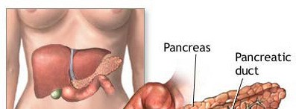
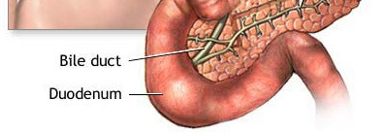

Slide 13
How insulin Act?

Slide 14
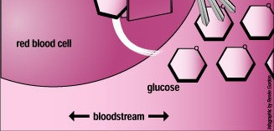

Slide 15
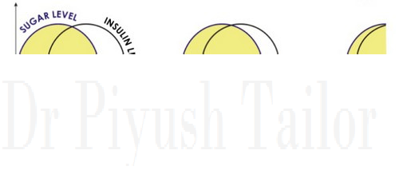
Insulin & Sugar Always together

Slide 16
7išAHAGE MT TTPE
7 DIABETES ’fi/ITH

Slide 17
Diabetes Mellitus
Type 1 Diabetes
insulin producing cell destroyed
insulin dependence
before 13 years
Type 2 Diabetes
- Lack of insulin action (resistant cells)
- commonly detected after 40 years
Gestational Diabetes
during pregnancy

Slide 18
Types of Diabetes Mellitus
Type 1:
Body's failure to produce insulin.
Type 2:
Insulin resistance
Sometimes combined with relative insulin deficiency.
Gestational diabetes:
Gestational diabetes affects about 4% of all pregnant women.
It may precede development of type 2 .

Slide 20
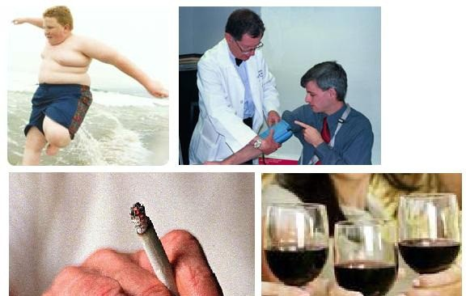
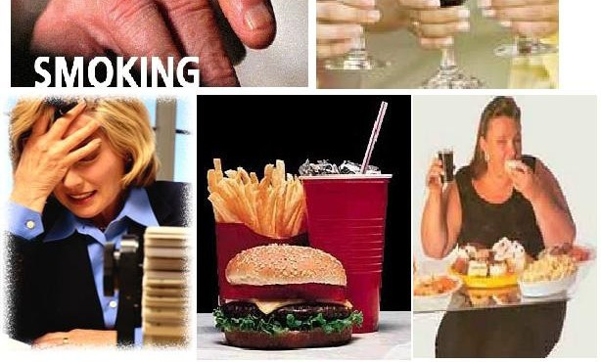

Slide 21
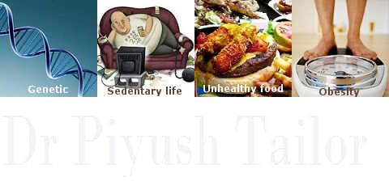

Slide 22
SIGNS & SYMPTOMS

Slide 23
Signs and Symptoms
Polyuria (excessive urination)
Polydipsia (excessive thirst )
Polyphagia (strong desire to eat)
Weight loss

Slide 24
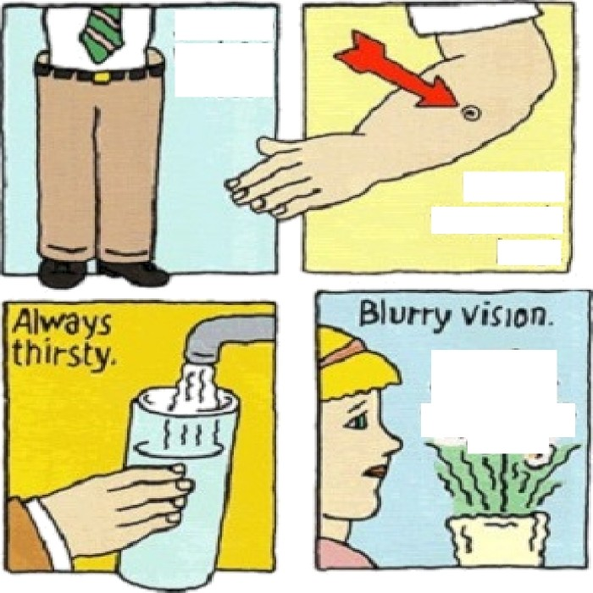
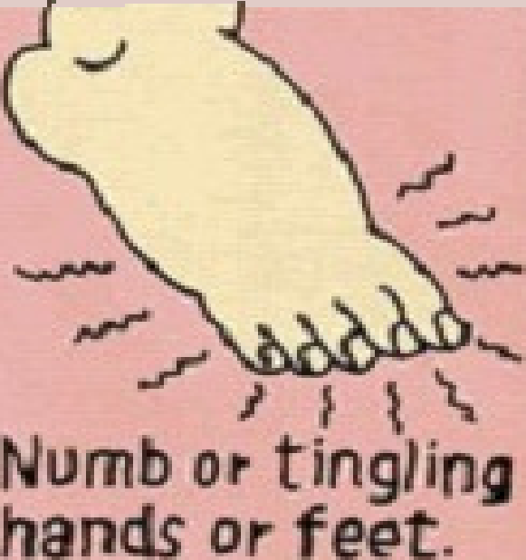
that aarït
heal.
Faginat
infe‹tï0ns.

Slide 25
Later Symptoms
Fatigue
Dry skin
Abnormal high frequency of infection
Feet Ulceration
Loss of sensibility in lower extremities
Erectile dysfunction
Slow Healing of wounds or sores
Changes in vision

Slide 26
Am I diabetec patient ?

Slide 27
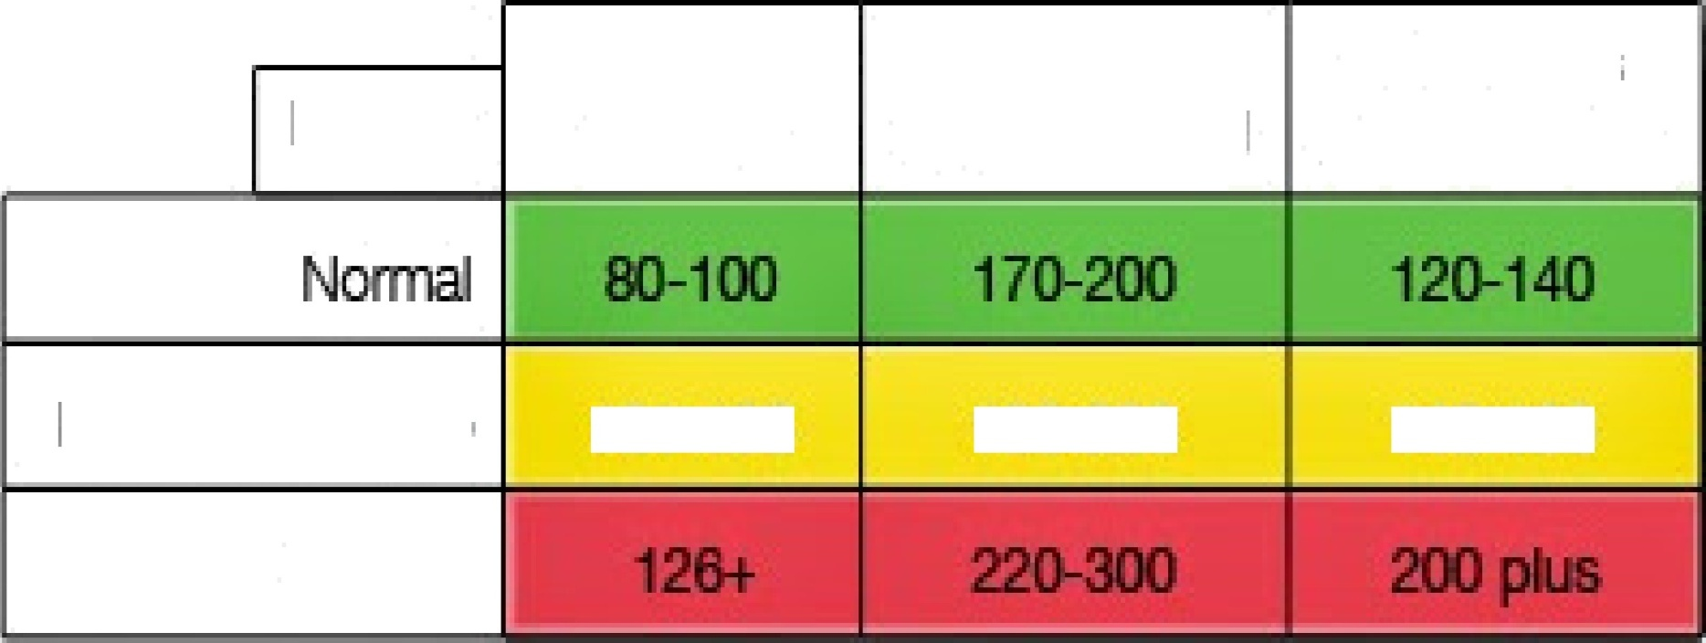
BLOOD GLUCßSE CHART
2-3 houæ
Mg/DL
Fã9tlng After Eating
xfter Eating
l/T1ğdİØÖ QIMCOSB
101-125
1B0-2Œ
14&100
DİüÖOtİC

Slide 28
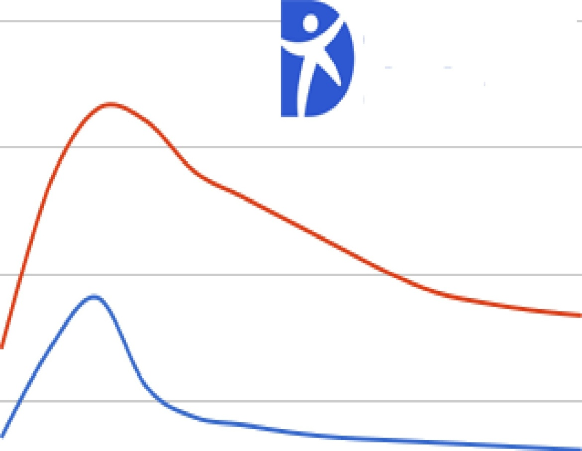
diabetes
daily
NOn-DİBD@İE (Blue) V. DİBb@İE (Ïšed) żśeBltİme Blood Sugars
250
200
a*’
150
100
50
0
1
2
3
4
5
6

Slide 29
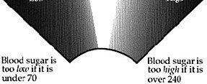

Slide 32
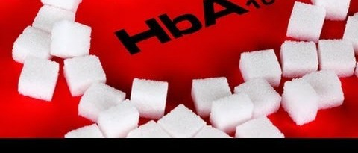
Glycate Haemoglobin

Slide 34
Compilcations of of Diabetea
Brain (stroke,TIA) Eye (blindness)
Heart {angina, heart attack) Kidney disease
High blood pressure
Male organ (erectile dysfunction)
Loss of legs or feet
Peripheral neuropathy (nerve disease)

Slide 35
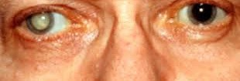
Cataract

Slide 36
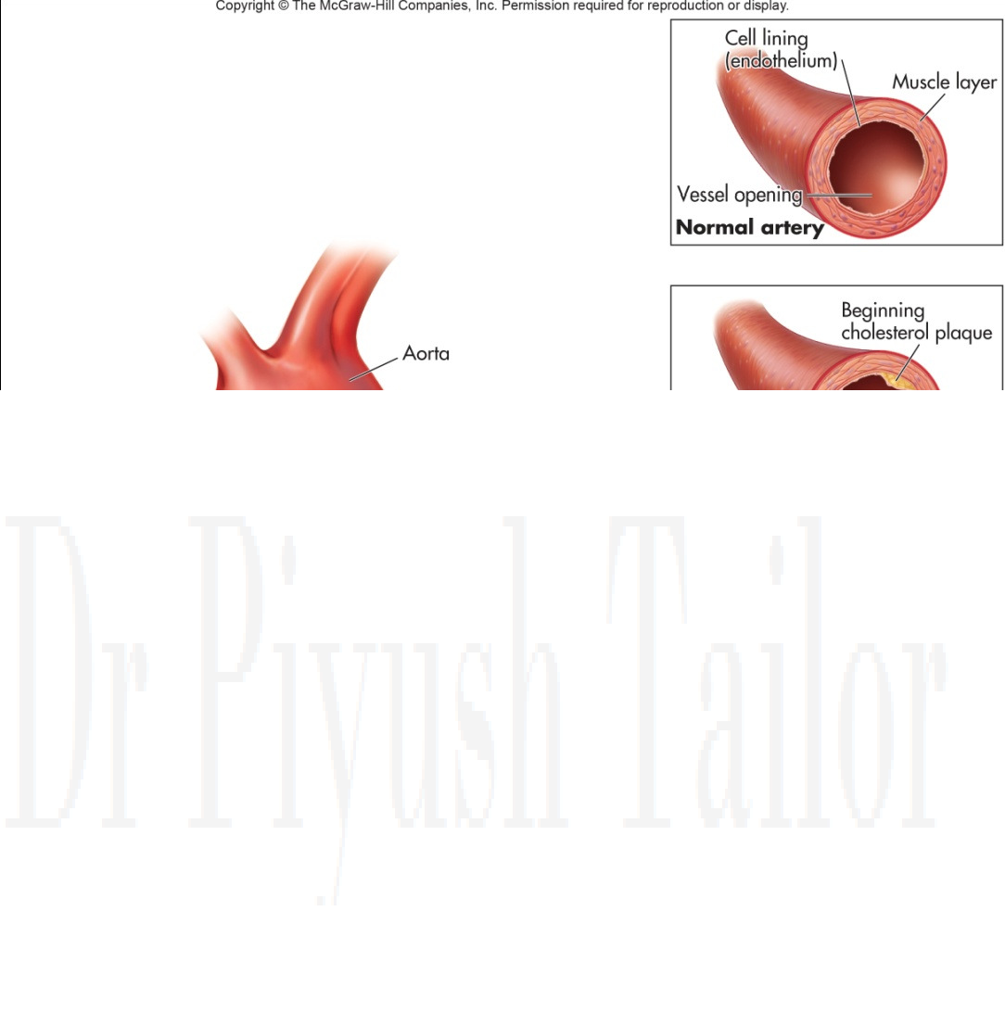
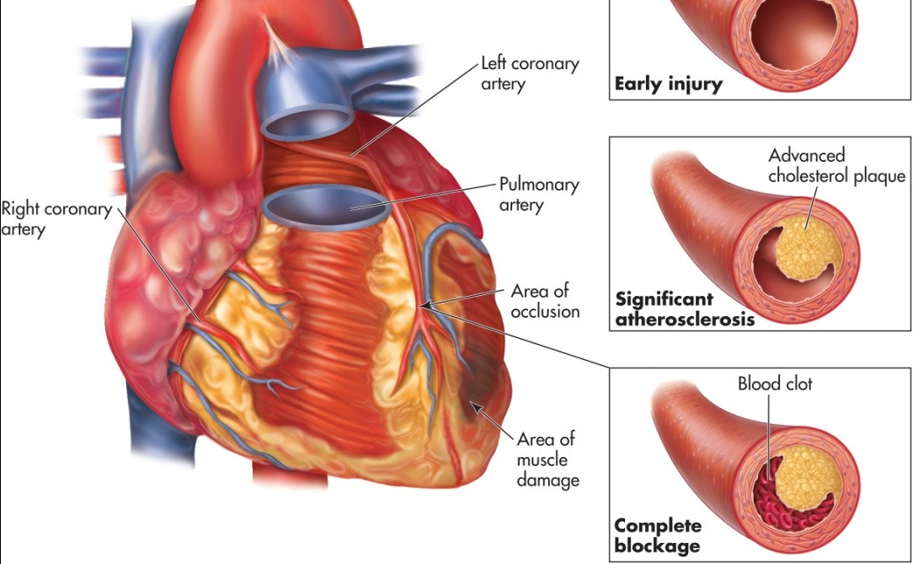
Heart Disease

Slide 37
Neuronal - Disease

Slide 38
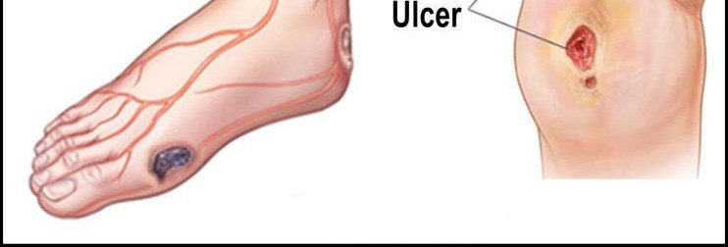

Slide 39
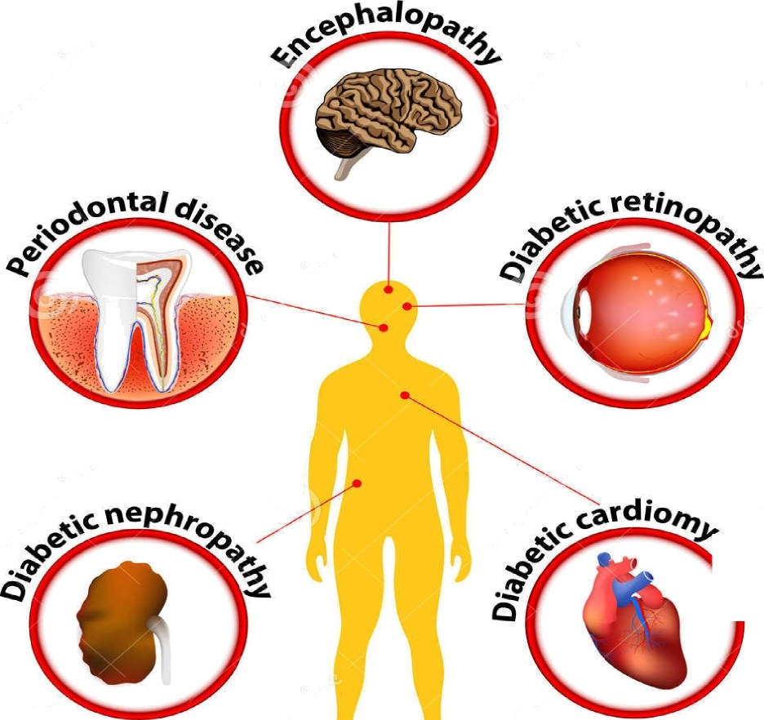
œooaw›sœeaiQ|wnu£soQ
0
ŁMOfi‘ØLMțțSlJJRdJØ
DIABETES MELLITUS (Type£ )

Slide 40
tose
s»i
Active
Enjoy a heart- healthy file

Slide 41
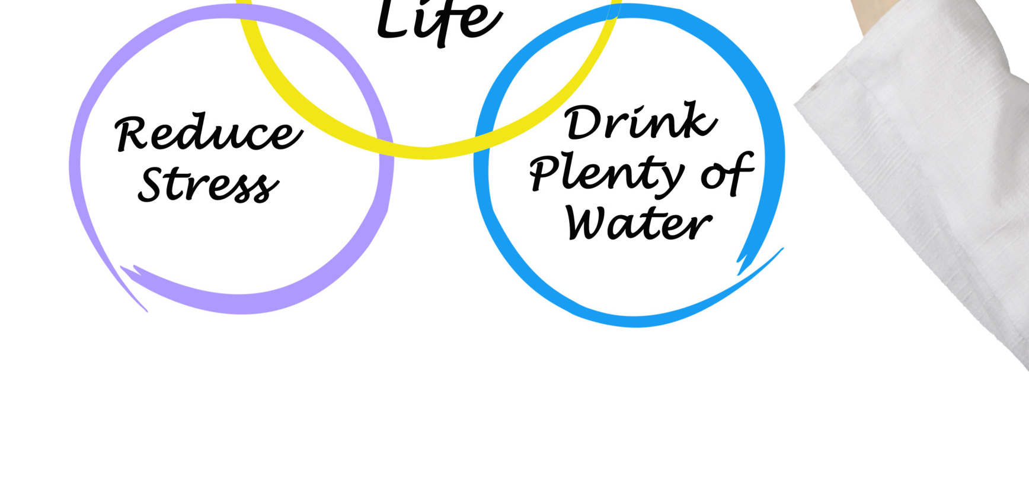

Slide 43
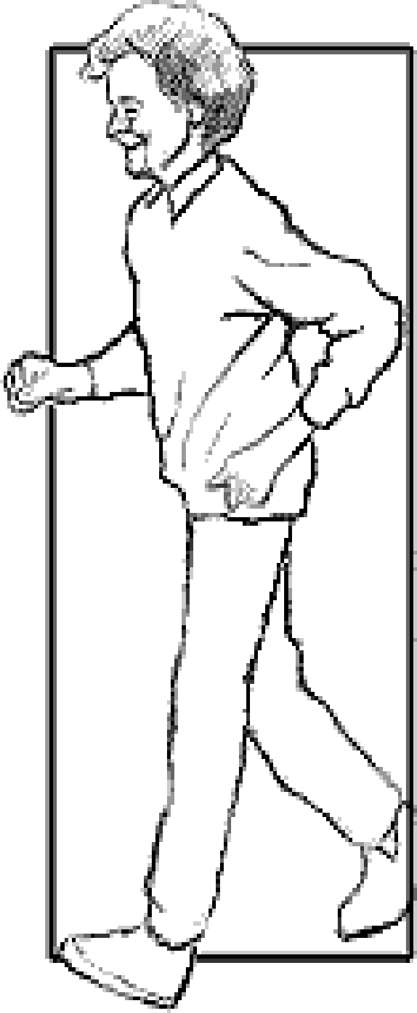
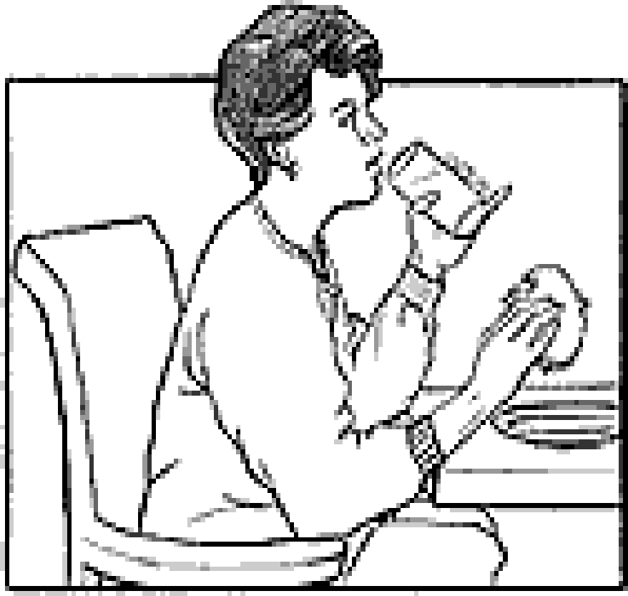
Dia
Controi
Healthy Eating
Exercise

Slide 44
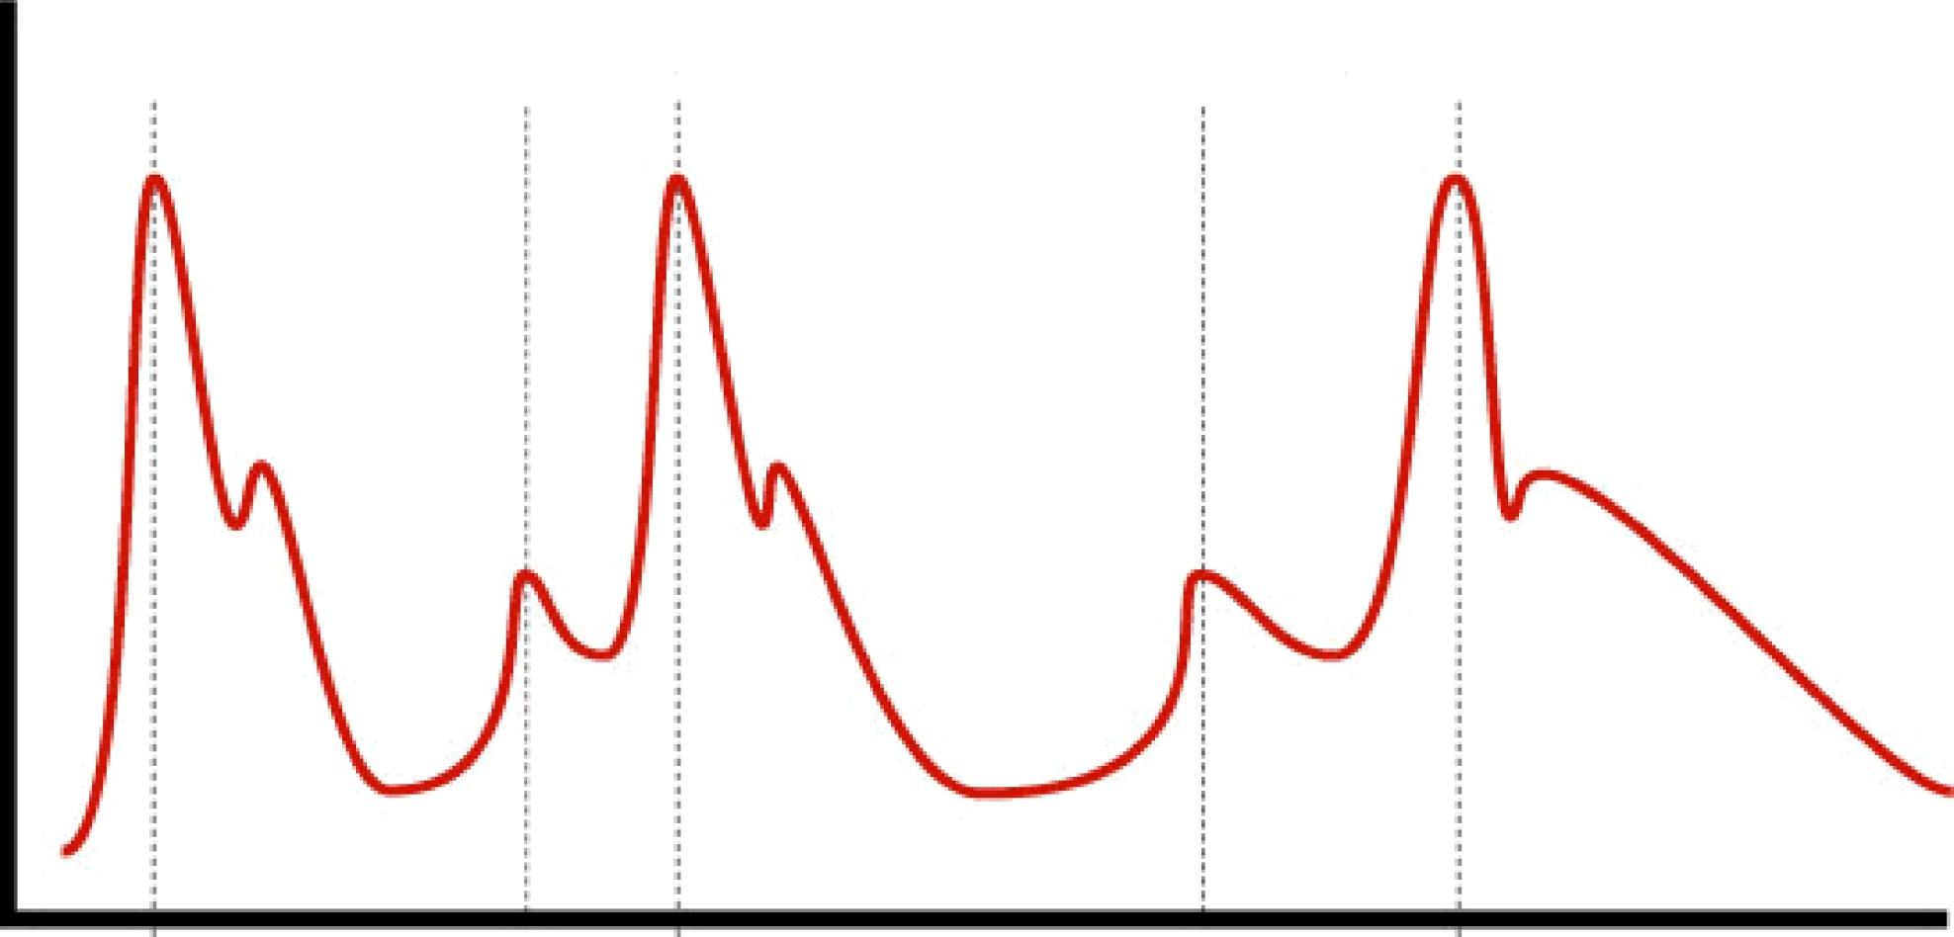
snacx
Snack
¿o grams
carbohydrate
,qO g>ms
carbolij-dl«te
BloodG lucose
Lunch
carbo1i3•ll'nte
Breakfast
carbohydrate
iinner
6o grams
cnl'bohydrate

