Slide 14
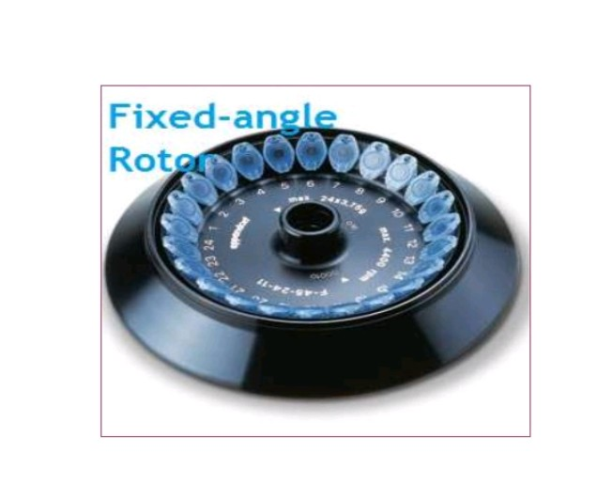

Slide 22
Ensure that centrifuge bowls and tubes are dry.
Ensure that the spindle is clean.
Use matched sets of tubes, buckets and other equipment.
Always use safety centrifuge cups to contain potential
spills and prevent aerosols.
Inspect tubes or containers for cracks or flaws before using them.
Avoid overfilling tubes or other containers (e.g., in fixed angle rotors, centrifugal force may drive the solution up the side of the tube or container wall).
Ensure that the rotor is properly seated on the drive shaft.
Make sure that tubes or containers are properly balanced in the rotor.
Only check O-rings on the rotor if you are properly trained.
Apply vacuum grease in accord with the manufacturer’s guidelines.
Do not exceed the rotor’s maximum run speed.
Close the centrifuge lid during operation.
Make sure that the centrifuge is operating normally before leaving the area.
Make sure that the rotor has come to a complete stop before opening the lid.

